Slide 1
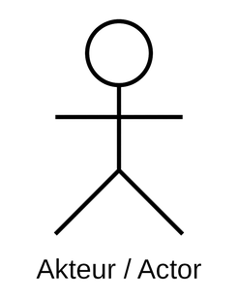

StayMatch
Use Case Diagram
<<Module: 01. Searching>>
01.01. Search by Zip
Support Team
01.02. Search by City
Landlord
Marketing Analyst
01.03. Search by Criteria
<<Includes>>
Sales Analyst
02. 04. Display Verified Properties
Renter
01.04. Sort by Price
Product Analyst

Slide 2
StayMatch
Use Case Diagram
<<Module: 02. Property Listing >>
02. 04. Display Verified Properties
<<Includes>>
02. 01. List Various Properties
Support Team
02. 02. Add Amenities
Landlord
Marketing Analyst
02. 03. Add Surrounding Areas
<<Includes>>
<<Extends>>
Sales Analyst
04. 02. Update Property
04. 01. Add Property
02. 01. List Various Properties
<<Includes>>
Renter
02. 04. Display Verified Properties
<<Includes>>
04. 01. Add Property
Product Analyst

Slide 3
StayMatch
Use Case Diagram
<<Module: 03. Account Management>>
03. 01. Register Renter
Support Team
03. 02. Modify Renter
Landlord
03. 03. Register Landlord
Marketing Analyst
03. 04. Modified Landlord
Sales Analyst
03. 05. Deactivate Renter
Renter
Product Analyst

Slide 4
StayMatch
Use Case Diagram
<<Module: 04. Property Management>>
04. 01. Add Property
Support Team
04. 02. Update Property
Landlord
04. 03. Delete Property
Marketing Analyst
04. 04. Show Property Summary
Sales Analyst
04. 05.Show Contact Information
<<Extends>>
Renter
<<Includes>>
Product Analyst
03.04 Modify Landlord
05.02 Validate Contact Info

Slide 5
StayMatch
Use Case Diagram
<<Module: 05. Property Validation>>
Support Team
05. 01. Validate Address
Landlord
Marketing Analyst
05. 02. Validate Contact Info
Sales Analyst
Renter
Product Analyst

